Slide 1
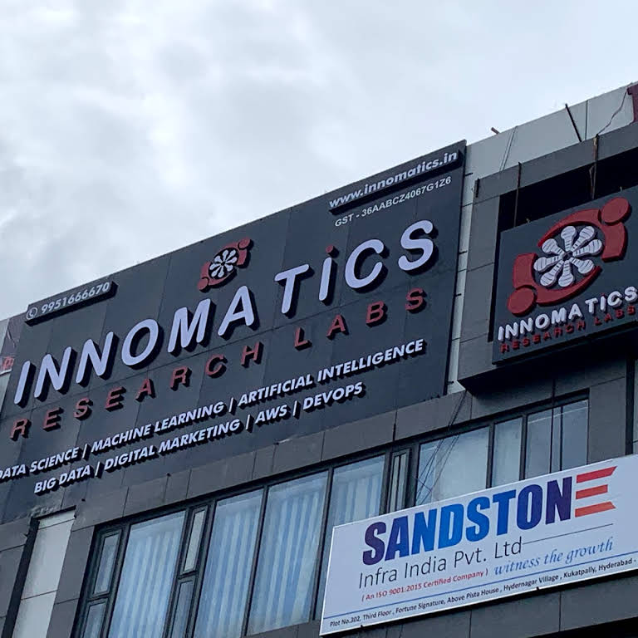
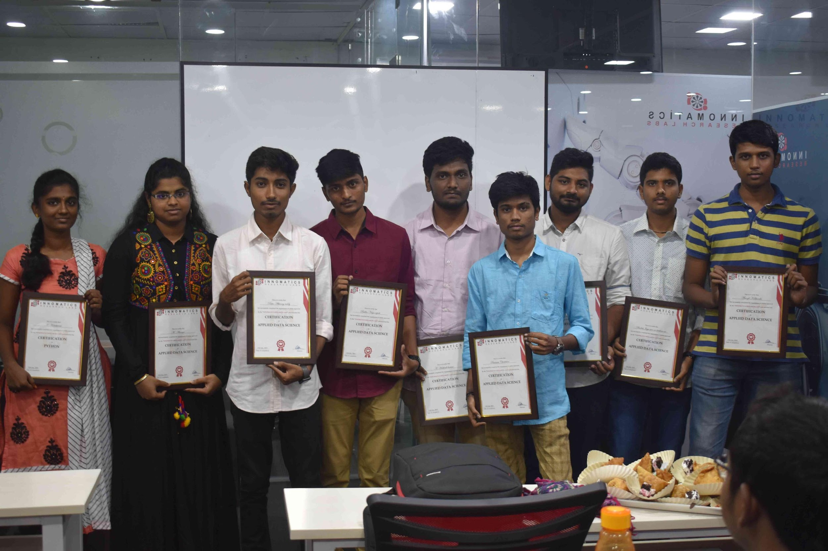
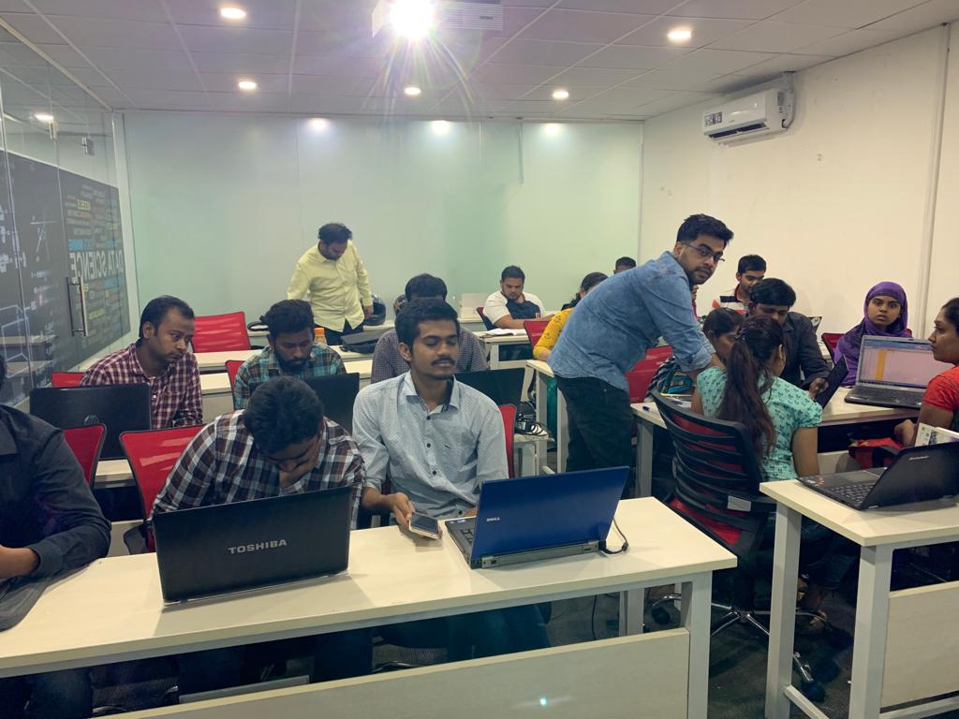

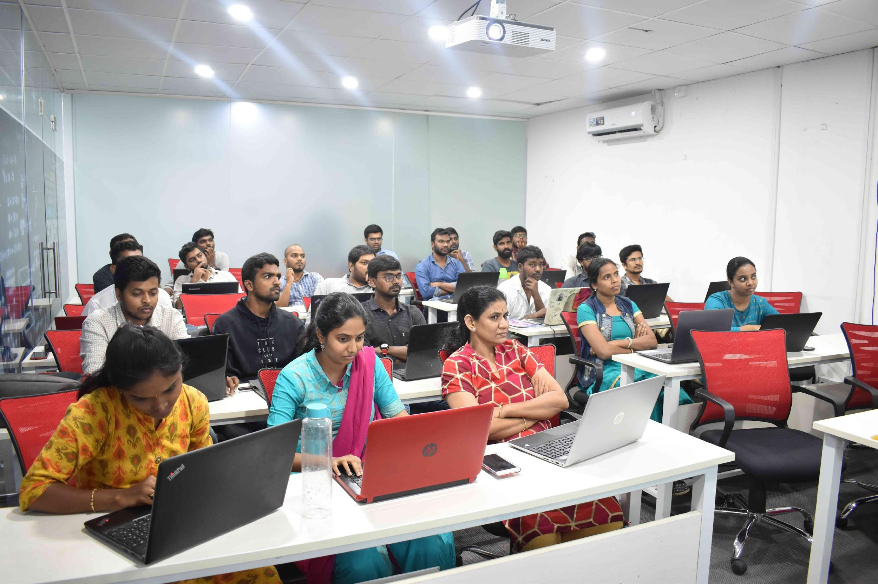
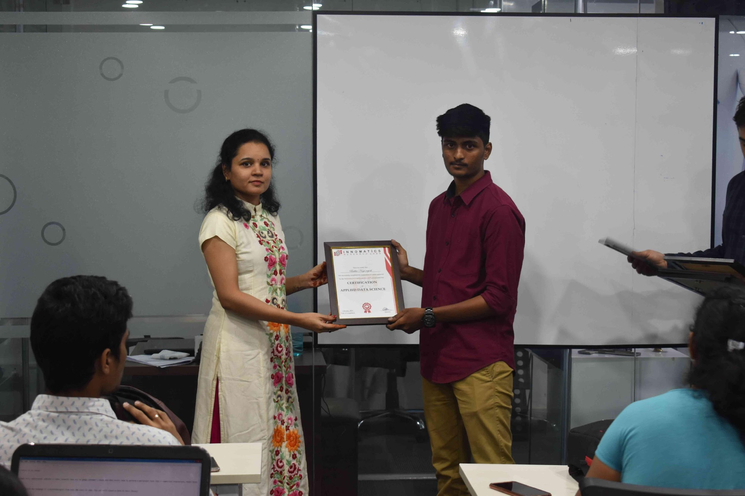
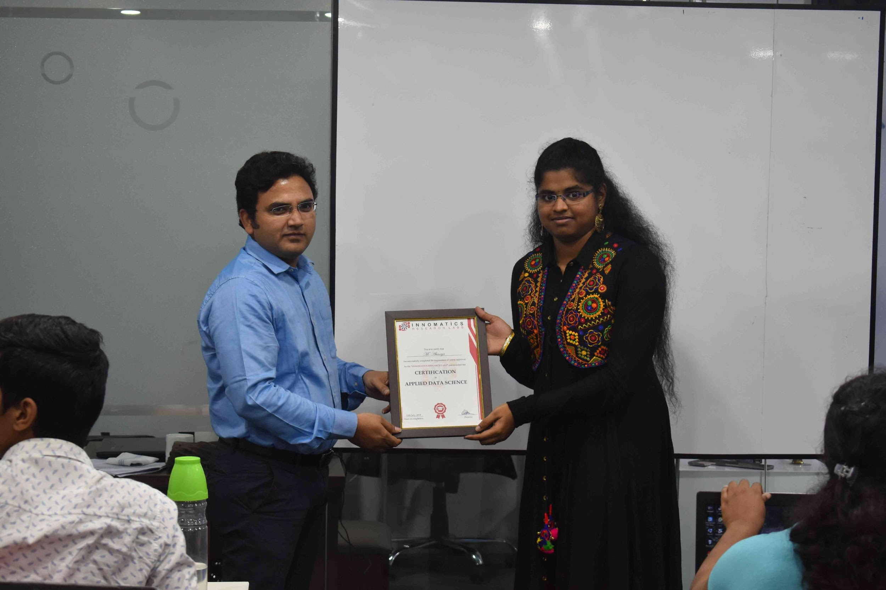

Slide 2
NOTE TAKER APP
By
Banoth keerthana

Slide 3
About me
Background ?
I am from B-tech (2022 Pass out) background perusing final year under Computer Science Engineering.
Why you want to learn Full Stack Development Course
As the current industries is booming with the full stack developers and and also as it helps me gain skills on both frontend as well as backend development
As a fresher I think that this will help me to start my career where I am able to work on both frontend as well as backend.
Any work experience
Currently I have no experience in the any company.
What like you about Innomatics Research lab
The way of teaching the skills regarding the full stack developer in innomatics is good

Slide 4
Project Presentation Flow:
Project Title:
Note Taker Application
Project Description:
You often feel completely overwhelmed with the amount of work you’ve got to do also You may sometimes forget to do things that are important it a struggle to keep up to deadlines so to overcome this problem of forgetting things the note taker application will help you take notes regarding what to be done along with the time with an option of green and red indicators which show your work status where red indicates the work has not been done and green indicates work has been done after the work is done the application allows you to delete the task which you have previously stored.
Technologies Used:
HTML , CSS
Bootstrap 4
JavaScript.

Slide 5
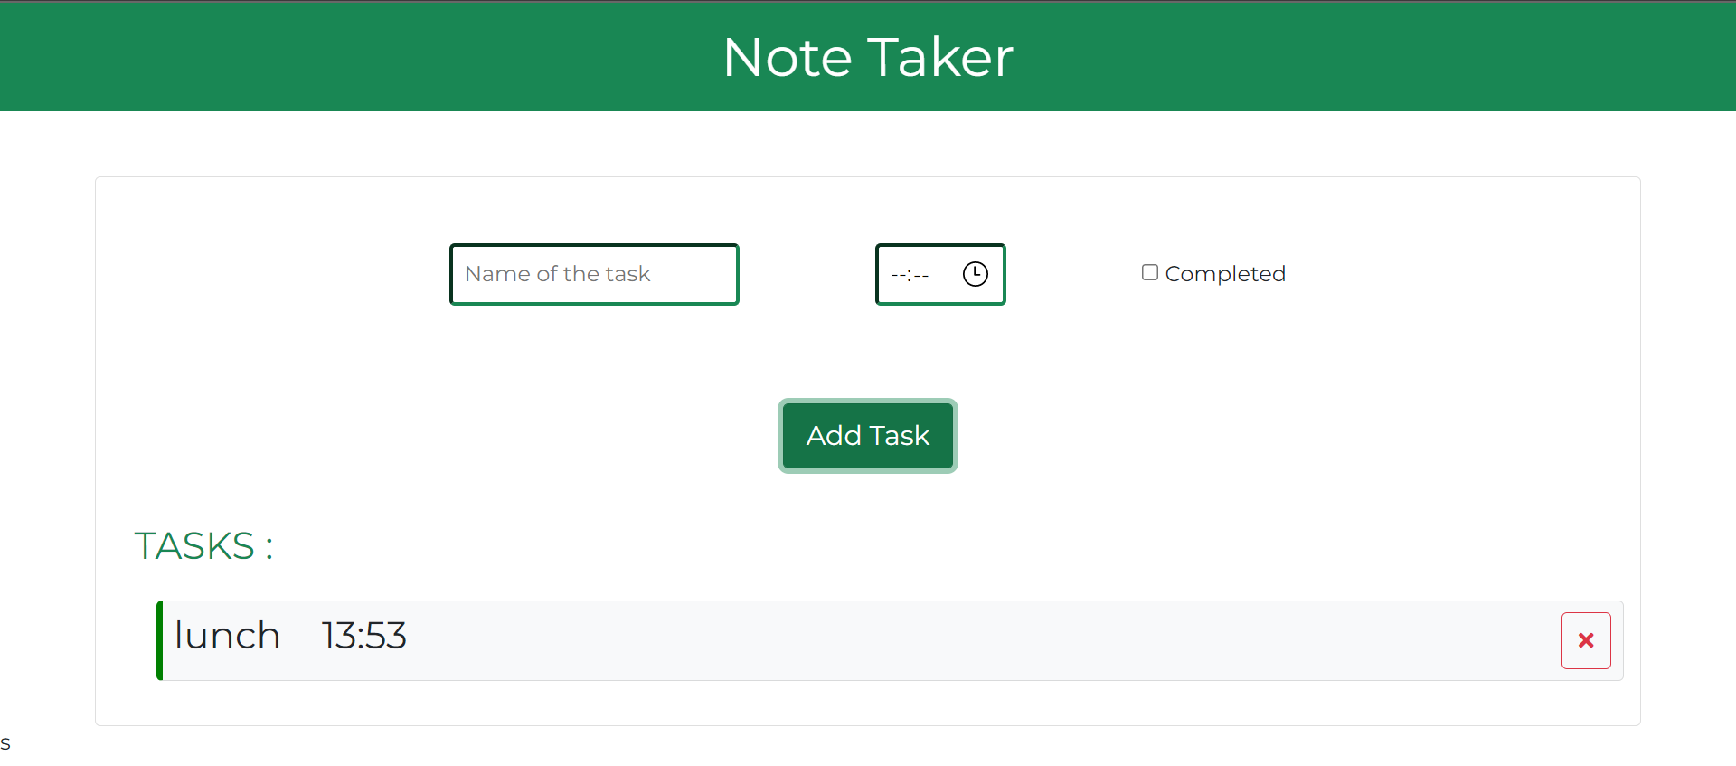
Screen shots of the application :

Slide 6
Project Presentation Flow:
Challenges in building the project:
Building this project was a bit challenging for me as it was my first project which was being build by my self some fields very difficult to find the answers for so to overcome this problem I searched in the Google regarding my problem during building the project on note taker where I could find solutions for my problem.
Experience in project building:
Project helps me understand the importance of different objects in the application building this application help me learn new things experience with this project building was good and building this project helped me understand the importance of front-end.

Slide 7

THANK YOU
By
Banoth keerthana

